Slide 1

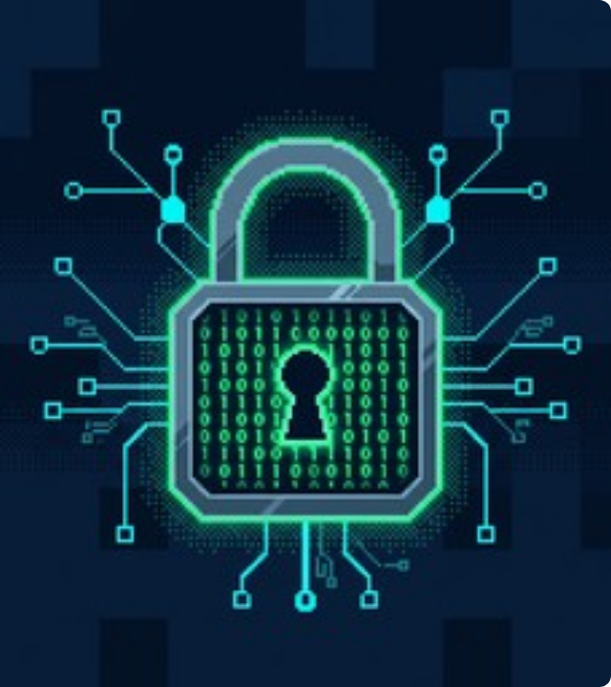

Phishing Attacks
Understanding, Detecting, and Preventing Cyber Threats through Social Engineering.
Presented by: Muhammad Izhan Siddiqui
Domain: Cyber Security
Organization: CodeAlpha

Slide 2


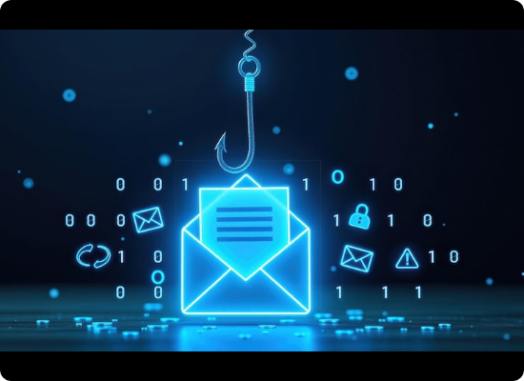
What is Phishing?
Phishing is a type of cyber attack where attackers disguise themselves as a trustworthy entity to deceive victims into revealing sensitive information, such as passwords or credit card numbers.
The Role of Social Engineering
Attackers do not just hack systems; they hack human psychology. They rely on:
▹ Urgency: "Your account will be suspended in 24 hours!"
▹ Fear: "Unauthorized login attempt detected."
▹ Curiosity: "Click here to view your bonus."

Slide 3

Spotting the Fakes
Fake Emails
Fake Websites
Always inspect emails carefully before clicking any links or downloading attachments:
If you click a link, verify the destination website before entering any credentials:
▹
Generic Greetings: Using "Dear Customer" instead of your actual name.
▹
Check the URL: Look for subtle misspellings (e.g., amaz0n.com).
▹
Suspicious Sender Address: Look closely at the email domain (e.g., support@paypal-alert.com instead of support@paypal.com).
▹
HTTP vs HTTPS: Secure sites use HTTPS. However, note that many phishing sites now use HTTPS too, so this alone is not enough.
▹
Poor Grammar: Spelling mistakes and odd phrasing are major red flags.
▹
Poor Design: Low-resolution logos, broken links, or formatting errors.
▹
Urgent Demands: Pressuring you to act immediately without thinking.
▹
Unusual Pop-ups: Immediate requests for login data upon loading.

Slide 4






Real-World Tactics
The Fake Invoice
CEO Fraud (Spear Phishing)
Account Suspension
An email arrives containing a fake invoice for a service you didn't buy. The attached "receipt" is actually malware designed to infect your system when opened.
A message claiming your Office365 or bank account is locked. It provides a link to a fake login page to "verify" your identity, stealing your credentials.
Attackers impersonate a company executive and email an employee, urgently requesting a wire transfer or sensitive HR data. Highly targeted and convincing.

Slide 5
Best Practices for Prevention
Think Before You Click Never click links or open attachments in unsolicited emails, even if they appear to be from known sources.
Enable 2FA / MFA Always use Two-Factor Authentication. Even if an attacker steals your password, they cannot access your account without the second factor.
Verify the Source If you receive a suspicious request, contact the person or company directly using a known, trusted phone number or website URL.
Keep Software Updated Regularly update your OS, browsers, and antivirus software to patch vulnerabilities that malware might exploit.

Slide 6




Interactive Module: What Would You Do?
SCENARIO
"You receive an urgent email from 'IT Support' stating your corporate email will be deleted in 2 hours due to inactivity. It includes a link to 'verify your account status'."
How do you respond?
Correct Answer: C. Never interact with the email. Report it through proper internal channels.

Slide 7

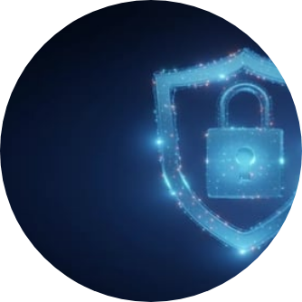
Conclusion
Human Firewall is the Strongest Defense
While technical controls like spam filters and antivirus software are essential, they are not foolproof. Phishing attacks specifically target human psychology.
By staying vigilant, educating yourself on social engineering tactics, and adopting a "zero trust" mindset toward unexpected digital communications, you become the strongest line of defense in the cybersecurity chain.
Stay Safe. Stay Secure.

